Slide 1
Developmental-Behavioral Pediatrics: Helping Military Children with Special Needs
R. Jason Gerber, MD
Lt Col, USAF, MC
Developmental Pediatrician
Naval Medical Center Portsmouth/Joint Base Langley-Eustis

Slide 2
Disclosures
The views expressed in this presentation are those of the author and do not necessarily reflect the official policy or position of the Department of the Air Force, the Department of the Navy, the Department of Defense, or the United States Government.
I am a military service member. This work was prepared as part of my official duties. Title 17 U.S.C. 105 provides that “copyright protection under this title is not available for any work of the United States Government.” Title 17 U.S.C. 101 defines a United States Government work as a work prepared by a military service member or employee of the United States Government as part of that person’s official duties.

Slide 3
Objectives
Describe the role of Developmental-Behavioral Pediatrics in evaluating children with developmental and/or behavioral concerns
List the factors considered in evaluation of a child with developmental and/or behavioral concerns
Identify the elements of IDEA that contribute to a child’s treatment plan
Describe some resources available through TRICARE and the military to help military-connected families with children with developmental and behavioral concerns

Slide 4
What is a Developmental-Behavioral Pediatrician?
Medical school (4 years)
Residency in Pediatrics (3 years)
Board certification in General Pediatrics
Developmental-Behavioral Pediatrics fellowship (3 years)
Board certification in Developmental-Behavioral Pediatrics

Slide 5
Range of Concerns or Disorders
Delays in motor skills (crawling, walking)
Delays in speech or language skills
Delays in social-emotional skills
Trouble sleeping
Trouble feeding or eating
Trouble with toilet training
Sensory processing difficulties
School problems

Slide 6
Range (continued)
Cerebral palsy
ADHD
Learning disabilities
Intellectual disabilities
Spina Bifida
Autism Spectrum Disorder
Tic disorders (including Tourette Syndrome)
Anxiety/Depression

Slide 7
Scope of Practice
Often part of a multidisciplinary team (therapists, psychologists, social workers, neurologists)
Provides more in-depth evaluation and perspective
Utilizes input from other specialists or evaluators to put the puzzle together and provide recommendations

Slide 8
Limited Resource
Less than 800 Developmental-Behavioral Pediatricians in the United States
6-12 month wait in most areas
36 uniformed military, 80+ military-connected
5 overseas
8500 child & adolescent psychiatrists
2000+ child neurologists

Slide 9
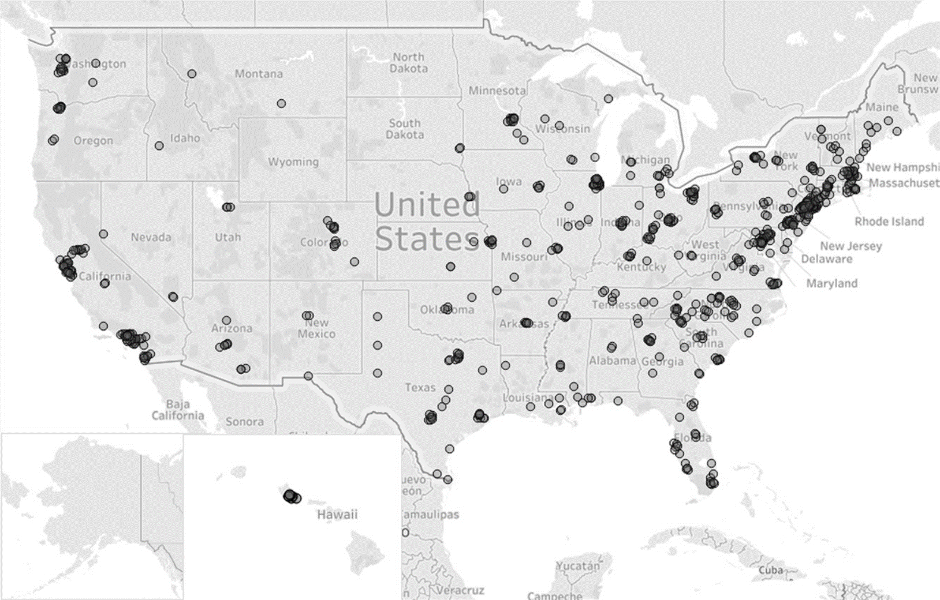

Slide 10
Signs of Delay or Disorder
16% of children have a Developmental Disability
Risk factors:
Prematurity
Perinatal adversity
Traumatic brain injury
Seizure disorder
Genetic disorder
Failure to meet developmental milestones
Failure to respond to routine parenting strategies

Slide 11
Contributing Factors
Medical
Family/Environmental stressors
Difficult temperament
Parental factors

Slide 12
Parent factors
Parent mental health
Ingrained behaviors
Childhood traumas
Exposure to poor parenting practices
Fear of repeating an unhealthy cycle
Fear of stigma (“label” from a diagnosis, perceived weakness for asking for help, perceived criticism of parenting skills)
Fear of unknown (how to handle a child so different than themselves)

Slide 13
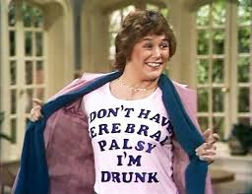
Cerebral Palsy

Slide 14
Evaluation
Begins with the primary care provider and routine developmental screenings
https://www.acf.hhs.gov/ecd/child-health-development/watch-me-thrive
Early Intervention services
Mental health for parenting strategies
Developmental Pediatrics

Slide 15
Elements of Intervention
Medical evaluations/treatments
Developmental or Educational services
Family support
Mental health

Slide 16
Early Intervention Services – Birth to 3
Neuroplasticity – the ability of the brain to form and reorganize synaptic connections, especially in response to learning or experience or following injury
Brains of infants and toddlers are primed for learning
Provided in all communities (Individuals with Disabilities Education Act or IDEA)
Overseas bases have dedicated Educational & Developmental Intervention Services (EDIS) teams to provide equivalent services to DoD families

Slide 17
Infant & Toddler Connection of Virginia
Self-referral or referral from the primary care provider
infantva.org of 1-800-234-1448
Evaluation within 45 days
Individual and Family Service Plan (IFSP) if eligible
Specific goals
Specific services

Slide 18
Special Education Services – 3 to 21
IDEA mandates a free and appropriate public education (FAPE) to children with disabilities
Schools required to find and evaluate students with suspected disability
Evaluation at NO COST to parents
Provide eligible students with special education and related services to meet their unique needs
Individualized Education Program (IEP)
Gives parents a voice in their child’s education

Slide 19
Special Education Eligibility
CATEGORIES: Autism, Deaf-blindness, Deafness, Emotional Disturbance, Hearing Impairment, Intellectual Disability, Multiple Disabilities, Orthopedic Impairment, Other Health Impairment, Specific Learning Disability, Speech or Language Impairment, Traumatic Brain Injury, Visual Impairment, Developmental Delay (through age 6)
Must have evidence of disability and as a result…
Must have Educational Impact (i.e., need special education services to make educational progress)

Slide 20
Least Restrictive Environment
To the maximum extent appropriate, children with disabilities must be educated with children without disabilities
Early Childhood Special Education Classroom
Developmental preschool program

Slide 21
Navigating the Special Education Arena
Parent Resource Centers
Available through each school district
Educational advocates
Understood.org
Wrightslaw.com

Slide 22
Reading disability

Slide 23
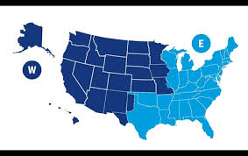
TRICARE
Military health benefit (not an insurance company)
Funded by Congress
Regional contractors
Humana Military – Eastern US
HealthNet Federal Services – Western US
International SOS - Overseas

Slide 24
TRICARE benefits
Medical evaluations and treatments
Extended Care Health Option (ECHO)
Additional services and supplies for beneficiaries with special needs (qualifying conditions)
Only available to active duty families
Dental services

Slide 25
TRICARE benefits (cont)
Hearing & Vision services
Therapy services
Early intervention services (ST, OT, PT)
Applied Behavioral Analysis (ABA) for children with Autism Spectrum Disorder
Private ST, OT, PT “above and beyond what is provided by public school sources”

Slide 26
TRICARE benefits (cont)
Behavioral and Mental Health Services
Self-referral to TRICARE network providers
NMCP Child Mental Health – requires referral
Under age 8 – focus is primarily effective parenting strategies
Over age 8 – more direct therapy for individuals as well as support for parents
Residential Treatment Center

Slide 27
Autism Spectrum Disorder

Slide 28
Other Military Resources
Exceptional Family Member Program (EFMP)
Mandatory enrollment for specific medical, developmental, and behavioral health conditions
Assignment tool
Enrollment form is the same for each service (DD 2792)
Mental Health addendum
Developmental or Autism addendum
Management of the program is slightly different for each service

Slide 29
Other Military Resources (cont)
EFMP Resource Centers
Fleet & Family Services (Navy)
Airman & Family Readiness (Air Force)
Army Community Services
Marine Corps Community Services
EFMP Respite Care

Slide 30
Other Military Resources
Fleet & Family Services Counselors
Military Family Life Counselors (MFLC)
FOCUS
Families Overcoming Under Stress
Couples, parents, families
Resiliency
Military One Source (militaryonesource.com)

Slide 31
Community Resources
Parent support groups (e.g. Autism Society of Tidewater)
Educational Advocacy (e.g. PEATC)
Resource Centers (Endependence Center, Versability)
Community Services Board
Care Connection for Children (CHKD)

Slide 32
Intersection with Mental Health
Developmental disorders often have comorbid mental health conditions
Anxiety
Depression
ADHD
Evaluation for possible developmental component
Behavior management strategies/parenting strategies
Medication management

Slide 33
Summary
Developmental-Behavioral Pediatrics focus on early identification, intervention, and resource coordination
Military-specific benefits and resources are available for families with special needs

