Slide 1
The Military Lifestyle: Exploring the Unique Social and Cultural Context of the U.S. Military
Sidra Montgomery, Ph.D.
Researcher, Insight Policy Research
@sidramontgomery

Slide 3
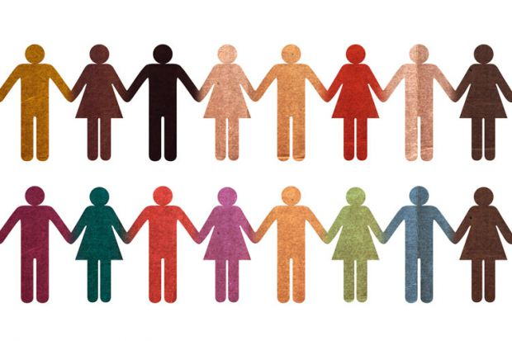
Sociology

Slide 4
Sociological Imagination
Public issues
Private Troubles
Notes:
The sociological imagination is “the ability to see the relationship between individual experiences and the larger society” (Kendall 1998: 7). Mills wrote that the “task of sociology is to realize that individual circumstances are inextricably linked to the structure of society”, which “enables us to grasp history and biography and the relations between the two within society (Eitzen et al. 2009: 14 and Mills 1959: 9). This allows us to understand how one’s private troubles are connected to personal issues.

Slide 5
Demographic make-up of the military
Military service and the lifecourse
What makes the military institution unique?
Common challenges for servicemembers, spouses, and families

Slide 6
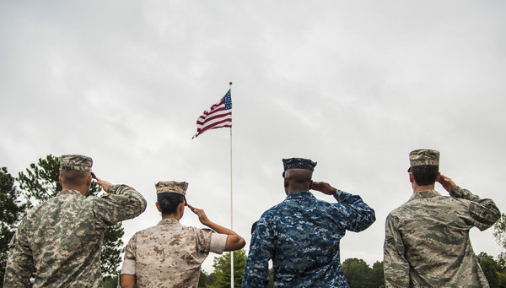
Who Serves in the U.S. Military?
Demographic characteristics of the 21st century force

Slide 7
Who Serves in the U.S. Military?
Active-Duty (2017):
Rank: 82% Enlisted; 17% Officers
Age: 45% 25 or younger, 21% 26 to 30 years old, 33.8% 31 or older
Race and Ethnicity: 68% White, 17% Black/African-American, 4.5% Asian; 15% Hispanic/Latino Ethnicity
Gender: 83% Male, 16% Female

Slide 8
Who Serves in the U.S. Military?
Active-Duty (2017):
Marital Status: 52% married, 42% never married, 5% divorced
Children: 38% have children
Geographic Region: primarily from the South
Family Service: 80% have family service, 25% have parents who served
Socioeconomic Background: Lower to middle class

Slide 9
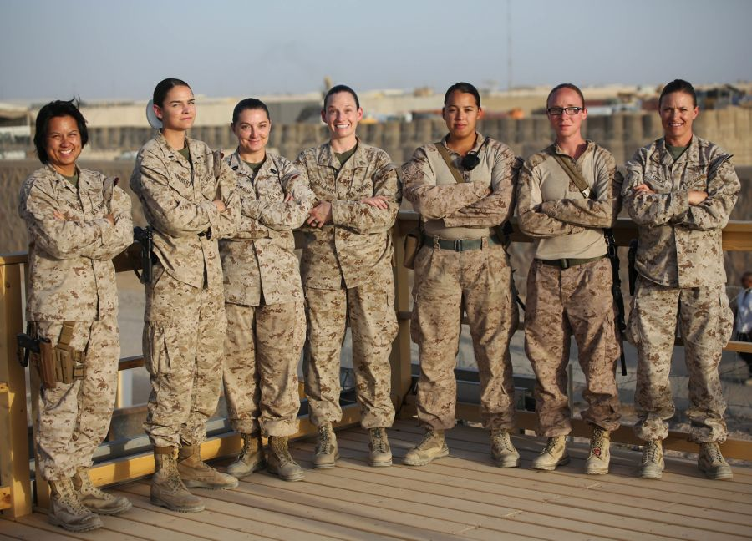
Military Service and the Life Course
Intersection of life
and service

Slide 10
Military Service and the Lifecourse
Lifecourse Perspective: how does historical time and place shape lives?
All-Volunteer Force
Post-9/11 generation
Iraq and Afghanistan wars
Widest gap between military service and civilian lives

Slide 11
Military Service and the Lifecourse
Lifecourse Perspective: the meaning, impact, and timing of life transitions
Transition to Adulthood:
Financial independence
Identity shifts
Intimate partnerships and family formation
Education and professional experience
Physical and psychological health

Slide 12
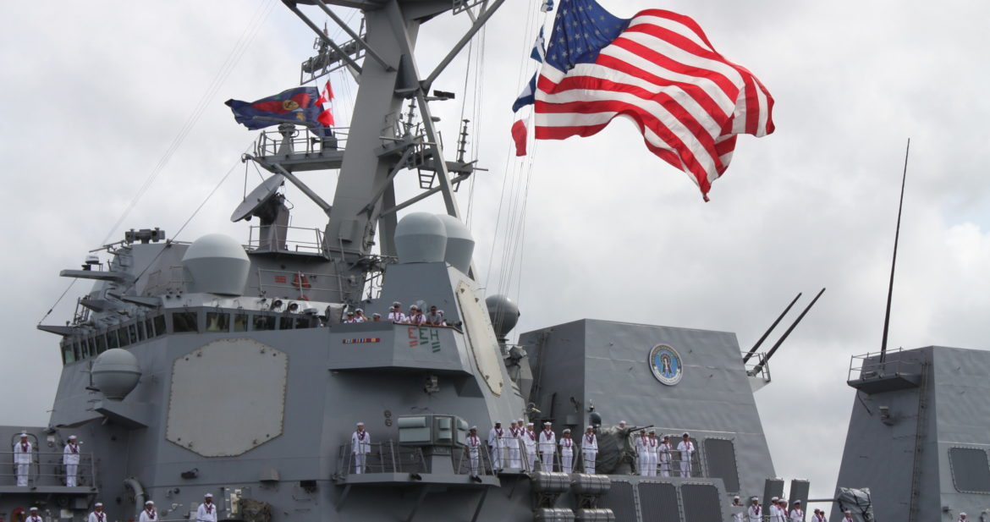
What Makes the Military Institution Unique?
Not your normal profession/occupation

Slide 13
Military as a “greedy institution”
Greedy institutions “seek exclusive and undivided loyalty and they attempt to reduce the claims of competing roles and status positions on those they wish to encompass within their boundaries. Their demands on the person are omnivorous…”
(Coser 1974: 6)

Slide 14
The military is unique in the “constellation of requirements” and “pattern of demands” it makes of it’s servicemembers and their families…
(M. Segal 1986: 15)
Risk of Injury or Death
Geographic Mobility
Separations
Residence in Foreign Countries
Normative Constraints

Slide 15
Social and Cultural Norms in the U.S. Military
Substantial socialization process
Hierarchy (structural and social)
Customs, traditions, and legacies
Explicit Values (honor, loyalty, respect, integrity)
Discipline and mental/physical toughness
Masculine-dominated
Warrior symbol and warrior ethos
Sub-cultures based on Service branch, occupational specialty, etc.

Slide 16
Military instiution
Servicemembers
Spouses, Children, Family Members
“Greedy” nature of the military extends beyond servicemembers, it also impacts families

Slide 17
Common Challenges Among Military Families
Impacts of the military lifestyle

Slide 18
Military Spouse Employment
Financial Wellness
Mental Health
Community Connection

Slide 19
Military Spouse Employment
Factors: Frequent geographic mobility, deployments, and local military installation labor markets
16-24% of military spouses are unemployed
Underemployment can be an even larger issue
Military spouses are losing income, retirement benefits, and may lack career progression or advancement

Slide 20
Military Family Financial Wellness
Factors: Frequent geographic mobility, spouse employment issues, early family formation
60% of families do not have enough savings to cover three months of living expenses (MFAN 2017)
15% of military families report issues of food insecurity (Wax and Stankorb 2016)
PCS moves can cause additional financial stress

Slide 21
Military Family Mental Health
Factors: Lifestyle stress and strain, family separation, military culture
Stigma of mental health problems in military, supposed to be “resilient” spouses who “do it all”
Depression, anxiety, and mental health challenges for military spouses
Moving and deployments can be challenging for children’s mental health and wellness

Slide 22
Military Families and Community
Factors: Frequent geographic mobility, disconnect with civilians, military culture and norms
Geographically distant from family and friends
Lack of connection and investment in local civilian community
Isolation, even within military community

Slide 23
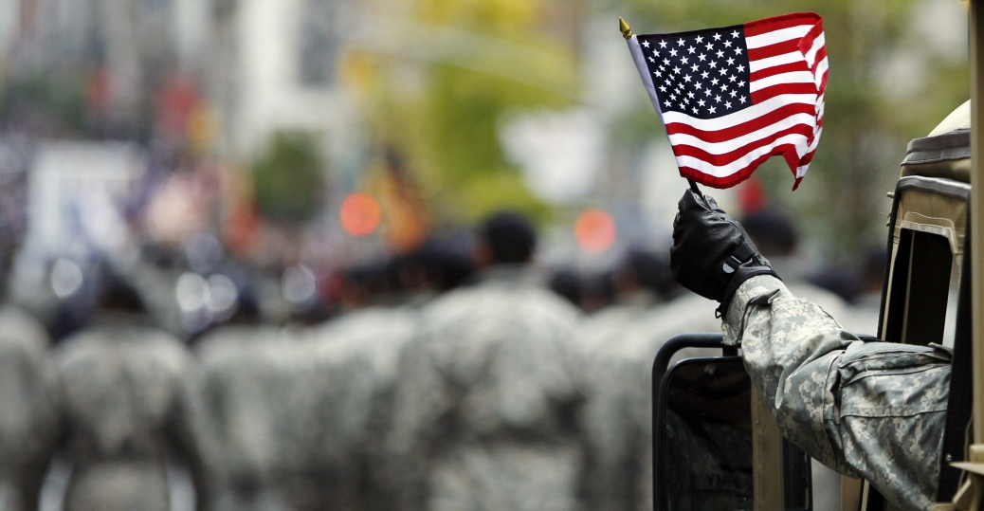
In Summary
Use sociological imagination to better understand the structure and social context of U.S. military
How institutional demands shape the lives of servicemembers and their families
Identify some of the common challenges within the military community

Slide 24
Thank You!
Sidra Montgomery, Ph.D.
sidra.montgomery@gmail.com
@sidramontgomery
Notes:
Thank you! I look forward to your questions and comments!

